Slide 1
Trusty Bookshelf
Offline-first SwiftUI aplikacija sa lokalnim keširanjem
Anastasija Cvetković 2182
Notes:
Tema ove prezentacije je Trusty Bookshelf – iOS aplikacija za upravljanje listom knjiga, koja je napravljena kao demonstracija offline-first arhitekturnog obrasca. Tehnologije koje sam koristila su SwiftUI za UI, Core Data za lokalnu perzistenciju, i Swift Concurrency za sinhronizaciju sa serverom.

Slide 2
Sadržaj
Offline-first pristup
Ključne komponente
Arhitektura projekta
Core Data i model podataka
Sinhronizacija
Ključni dizajn paterni
Kreiranje projekta
Testiranje
Demonstracija aplikacije

Slide 3
Šta je offline-first?
• Lokalna baza je izvor istine, mreža je bonus
• Korisnik uvek dobija trenutni odgovor
• Podaci se ne gube usled gubitka konekcije
• Tri garancije:
1. Aplikacija funkcioniše bez interneta
2. UI reaguje momentalno
3. Nema gubitka podataka

Slide 4
Klasičan pristup vs. offline-first
Klasičan pristup | Offline-first
Korisnik klikne na dugme “Sačuvaj” | Korisnik klikne na dugme “Sačuvaj”
Aplikacija šalje zahtev na server | Aplikacija upisuje u lokalnu bazu
Čeka odgovor | UI se odmah ažurira
Prikazuje rezultat | Sync se dešava u pozadini
Notes:
Zamislite situaciju: korisnik je u liftu, ili leti avionom, ili jednostavno ima loš signal. U klasičnom pristupu, aplikacija šalje zahtev na server, čeka odgovor i tek onda ažurira UI. Ako mreže nema – akcija propada, korisnik dobija error poruku, i frustriran je.
Offline-first kaže suprotno: lokalna baza je izvor istine, a mreža je bonus. Korisnik klikne 'Sačuvaj' - podaci su odmah lokalno sačuvani i vidljivi. Kada mreža postane dostupna, sinhronizacija se dešava tiho, u pozadini. Korisnik to ne mora ni da primeti.

Slide 5
Ključne komponente
SwiftUI + @Observable → Reaktivni UI, iOS 17
Core Data / SQLite → Lokalna perzistencija
async/await + @MainActor → Thread-safe mrežni sloj
NWPathMonitor → Praćenje mrežne konekcije
JSONPlaceholder → Mock REST API (demo)
XcodeGen → Generisanje projekta iz YAML

Slide 6
Arhitektura projekta

Slide 7
BooksViewModel.swift
@Observable
final class BooksViewModel {
private(set) var books: [Book] = []
var errorMessage: String?
var showSyncLog: Bool = false
let networkMonitor: NetworkMonitor
let syncService: SyncService
func addBook(title: String, author: String, rating: Int,
notes: String, isRead: Bool) {
let context = persistence.viewContext
let entity = BookEntity(context: context)
let book = Book.new(title: title, author: author,
rating: rating, notes: notes, isRead: isRead)
entity.update(from: book)
persistence.save(context: context)
fetchBooks()
triggerSyncIfOnline()
}
func updateBook(_ book: Book, ...) { ... }
func deleteBook(_ book: Book) { ... }
}
private func observeNetworkChanges() {
var previouslyOnline = networkMonitor.effectivelyOnline
syncObservationTask = Task { @MainActor [weak self] in
while !Task.isCancelled {
guard let self else { return }
await withCheckedContinuation { continuation in
withObservationTracking {
_ = self.networkMonitor.effectivelyOnline
} onChange: {
continuation.resume()
}
}
let isOnline = self.networkMonitor.effectivelyOnline
if isOnline && !previouslyOnline {
await self.syncService.syncPendingBooks()
self.fetchBooks()
}
previouslyOnline = isOnline
}
}
}

Slide 8
Core Data – model podataka
id : UUID → generiše uređaj, offline kreiranje
title : String
author : String
rating : Int16
isRead : Boolean
notes : String?
syncStatus : String → "pending" / "synced" / "failed"
remoteId : Int64 → 0 = nikad sinhronizovano (sentinel)
createdAt : Date
updatedAt : Date

Slide 9
Domain model i separacija slojeva
Book.swift
struct Book: Identifiable {
let id: UUID
var title: String
var author: String
var rating: Int
var notes: String
var isRead: Bool
var syncStatus: SyncStatus
var remoteId: Int64
var createdAt: Date
var updatedAt: Date
}
BookEntity+Extensions.swift
extension BookEntity {
func toDomainModel() -> Book {
Book(
id: id ?? UUID(),
title: title ?? "",
syncStatus: SyncStatus(rawValue: syncStatus ?? "pending") ?? .pending,
remoteId: remoteId,
...
)
}
func update(from book: Book) {
self.title = book.title
self.syncStatus = book.syncStatus.rawValue
self.remoteId = book.remoteId
...
}
}

Slide 10
Dva Core Data konteksta
viewContext (main thread)
• Koristi SwiftUI za čitanje i prikaz podataka
• Nikad se ne blokira
backgroundContext (pozadinski thread)
• Koristi SyncService za pisanje
• automaticallyMergesChangesFromParent = true → pozadinski upisi automatski propagiraju na UI
Rezultat: UI nikad nije blokiran tokom sync-a

Slide 11
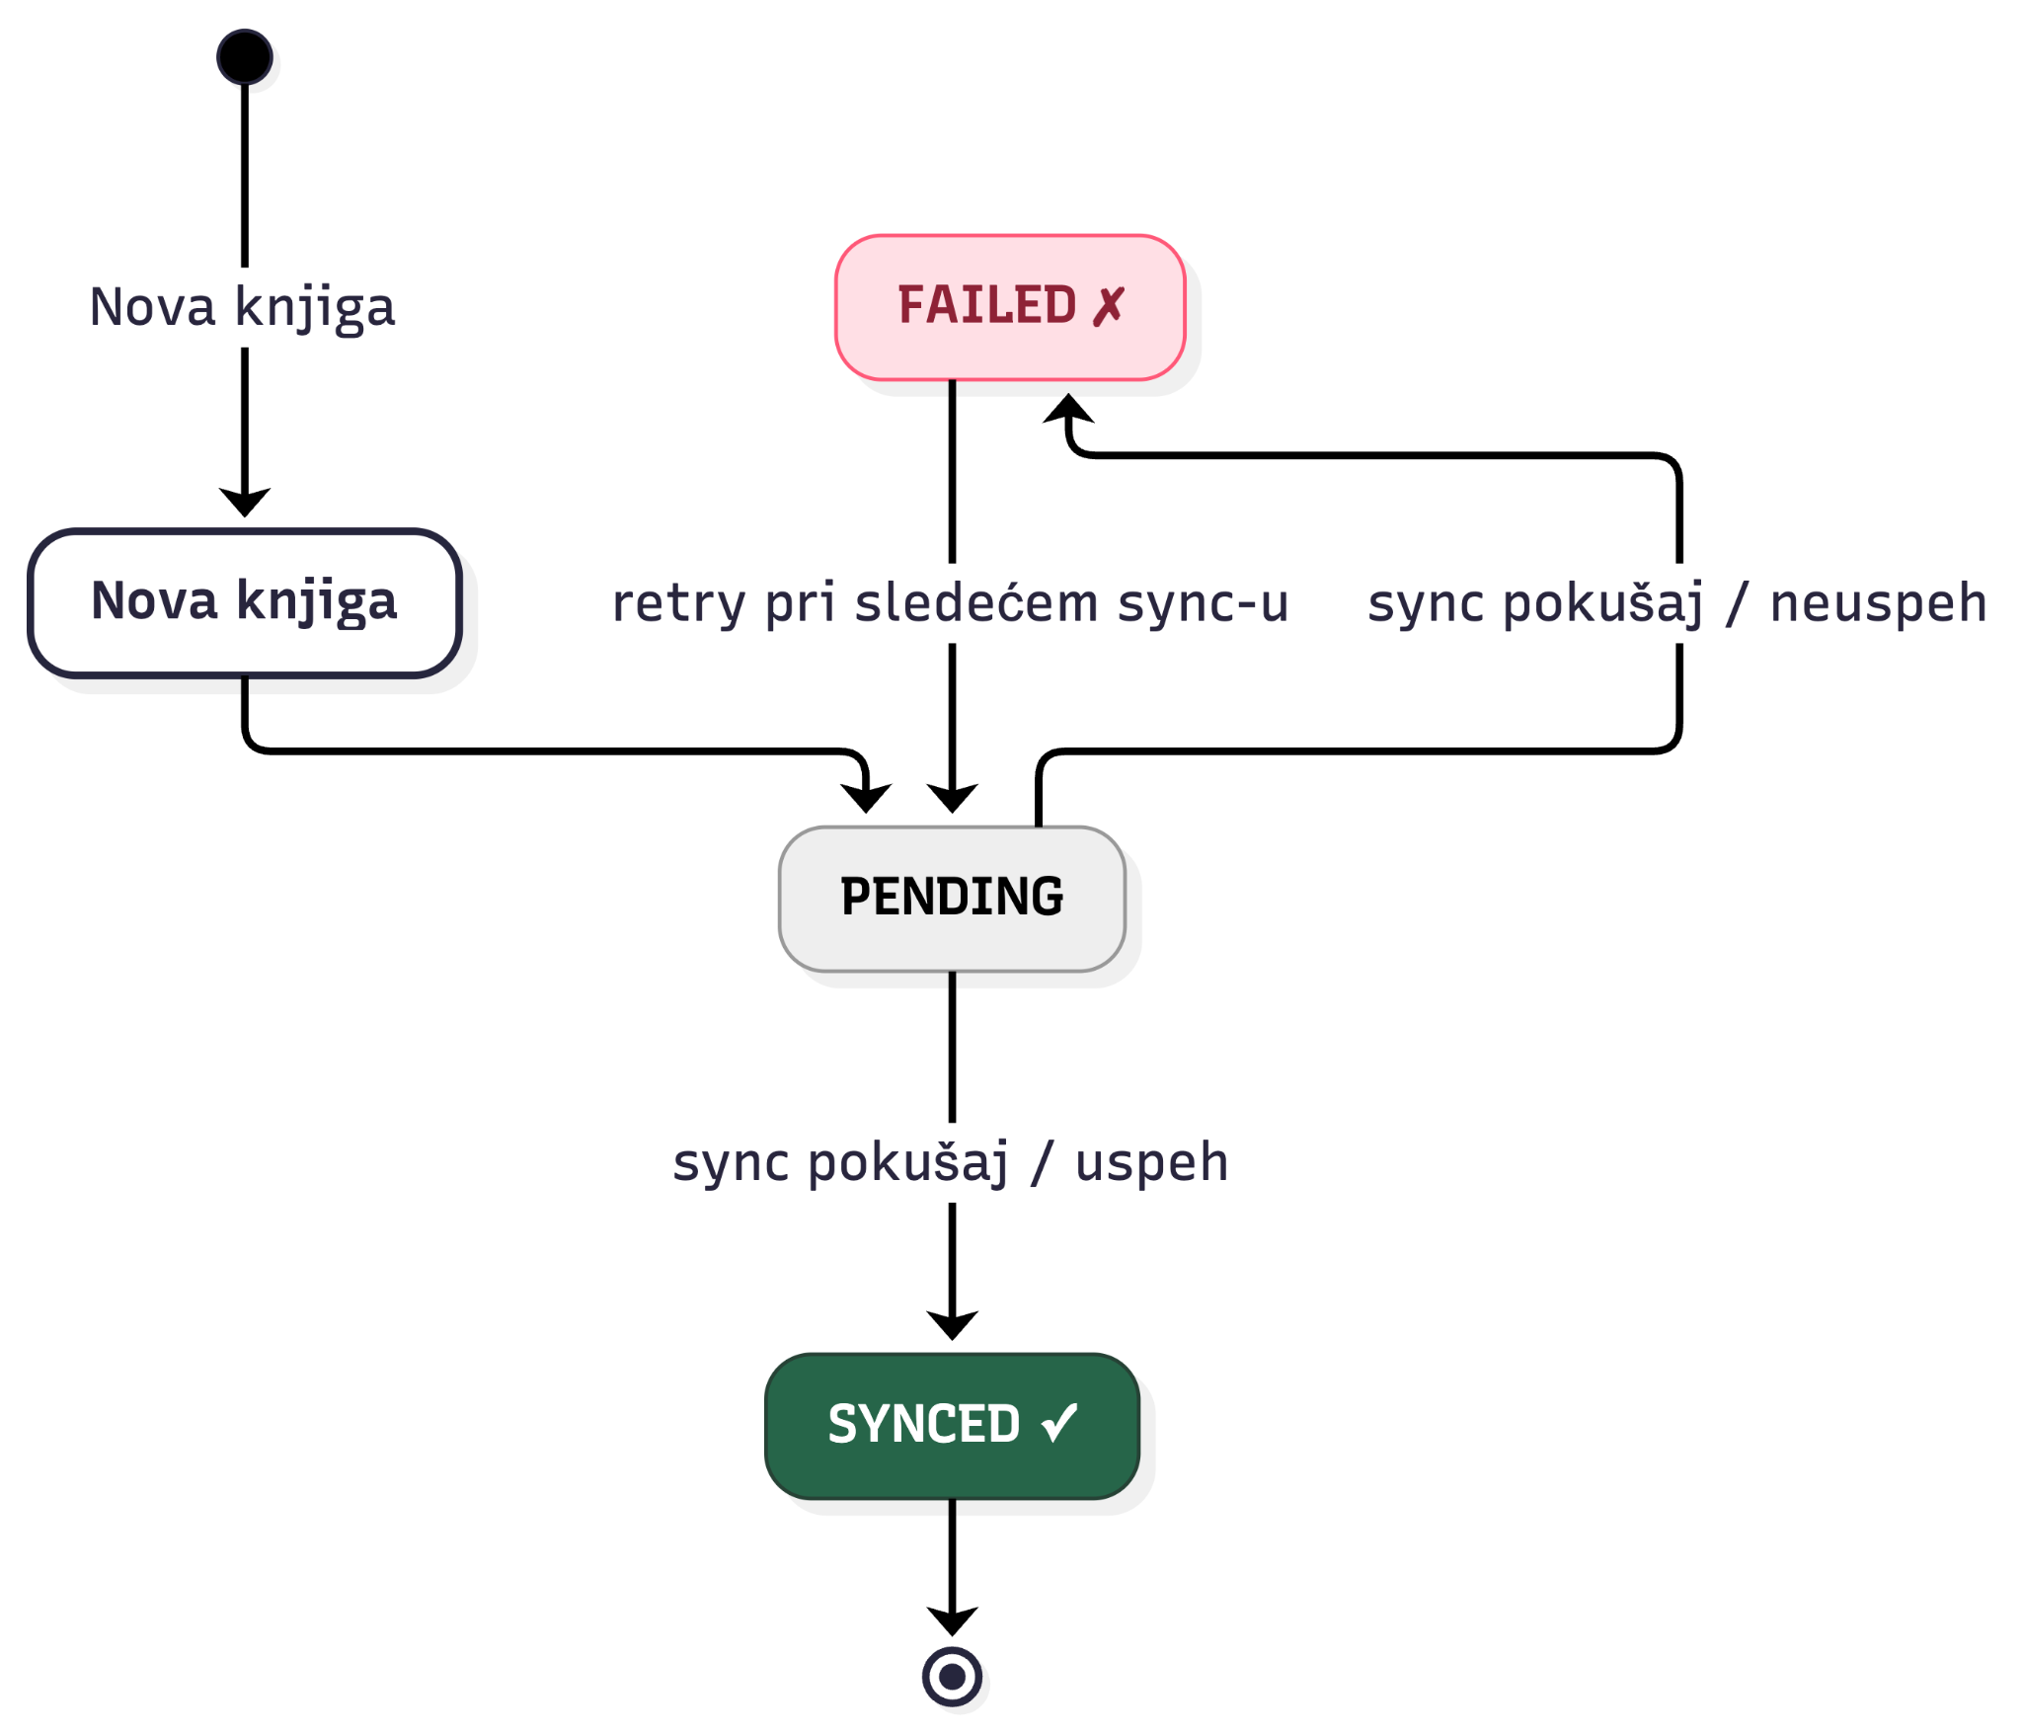
SyncStatus - prelazak iz jednog u drugo stanje

Slide 12
Sinhronizacija
Okidači:
• Kreiranje knjige (ako je online)
• Prelaz offline → online (automatski)
• Pull-to-refresh (ručno)
Logika po knjizi:
remoteId == 0 → POST (nova knjiga)
remoteId > 0 → PUT (izmena postojeće)
Zaštita od duplikata:
guard !isSyncing else { return }

Slide 13
SyncService.swift
func syncPendingBooks() async {
let alreadySyncing = await MainActor.run { isSyncing }
guard !alreadySyncing else { return }
await MainActor.run { isSyncing = true }
defer {
Task { @MainActor [weak self] in
self?.isSyncing = false
}
}
let context = persistence.backgroundContext
let pending = await fetchPendingEntities(context: context)
if pending.isEmpty { return }
for entity in pending {
await syncSingleBook(entity, context: context)
}
}
if currentRemoteId == 0 {
// New book — CREATE on server
let remote = try await api.createPost(title: title, body: ...)
await context.perform {
entity.remoteId = Int64(remote.id)
entity.syncStatus = SyncStatus.synced.rawValue
self.persistence.save(context: context)
}
} else {
// Existing book — UPDATE on server
let remote = try await api.updatePost(id: Int(currentRemoteId), ...)
await context.perform {
entity.syncStatus = SyncStatus.synced.rawValue
self.persistence.save(context: context)
}
} catch {
await context.perform {
entity.syncStatus = SyncStatus.failed.rawValue
}
}

Slide 14
NetworkMonitor.swift
@Observable
final class NetworkMonitor {
private(set) var isConnected: Bool = true
private(set) var connectionType: String = "Unknown"
var simulateOffline: Bool = false
var effectivelyOnline: Bool {
isConnected && !simulateOffline
}
private let monitor = NWPathMonitor()
private let queue = DispatchQueue(label:
"com.elfak.bookshelf.NetworkMonitor",
qos: .utility)
init() {
monitor.pathUpdateHandler = { [weak self] path in
DispatchQueue.main.async {
self?.isConnected = path.status == .satisfied
self?.connectionType = {
if path.usesInterfaceType(.wifi) { return "WiFi" }
if path.usesInterfaceType(.cellular) { return
"Cellular" }
if path.usesInterfaceType(.wiredEthernet){ return
"Ethernet" }
return "Other"
}()
}
}
monitor.start(queue: queue)
}
}

Slide 15
@Observable vs. ObservableObject
@Observable
final class BooksViewModel {
var books: [Book] = [] ← nema @Published
}
• Granularno praćenje - re-render samo za property-je koje view stvarno čita
• ObservableObject obaveštavaju sve view-ove pri svakoj promeni bilo kog property-ja

Slide 16
ApiService
class APIService {
private let baseURL = "https://jsonplaceholder.typicode.com"
private let session: URLSession
func createPost(title: String, body: String,
userId: Int = 1) async throws -> RemotePost {
guard let url = URL(string: "\(baseURL)/posts") else {
throw APIError.badURL
}
var request = URLRequest(url: url)
request.httpMethod = "POST"
request.setValue("application/json; charset=UTF-8",
forHTTPHeaderField: "Content-Type")
let payload: [String: Any] = ["title": title, "body": body, "userId":
userId]
request.httpBody = try JSONSerialization.data(withJSONObject: payload)
let (data, _) = try await session.data(for: request)
return try JSONDecoder().decode(RemotePost.self, from: data)
}
func updatePost(id: Int, title: String, body: String) async throws ->
RemotePost { ... }
func deletePost(id: Int) async throws { ... }
}

Slide 17
withObservationTracking
private func observeNetworkChanges() {
var previouslyOnline = networkMonitor.effectivelyOnline
syncObservationTask = Task { @MainActor [weak self] in
while !Task.isCancelled {
guard let self else { return }
await withCheckedContinuation { continuation in
withObservationTracking {
_ = self.networkMonitor.effectivelyOnline
} onChange: {
continuation.resume()
}
}
let isOnline = self.networkMonitor.effectivelyOnline
if isOnline && !previouslyOnline {
await self.syncService.syncPendingBooks()
self.fetchBooks()
}
previouslyOnline = isOnline
}
}
}

Slide 18
Kreiranje i inicijalizacija projekta
Preduslovi:
• Xcode 15+
• iOS 17.0 simulator ili uređaj
• Homebrew + XcodeGen
• macOS Sonoma ili noviji
Inicijalizacija projekta
1. Instaliranje XcodeGen-a
brew install xcodegen
2. Kloniranje repozitorijuma
git clone <repo-url>
cd elfak-advanced-software-engineering

Slide 19
Generisanje i pokretanje
3. Generisanje Xcode projekta
xcodegen generate
4. Otvaranje projekta
open “Trusty Bookshelf.xcodeproj”
5. Pokretanje
Xcode → Run (⌘R)

Slide 20
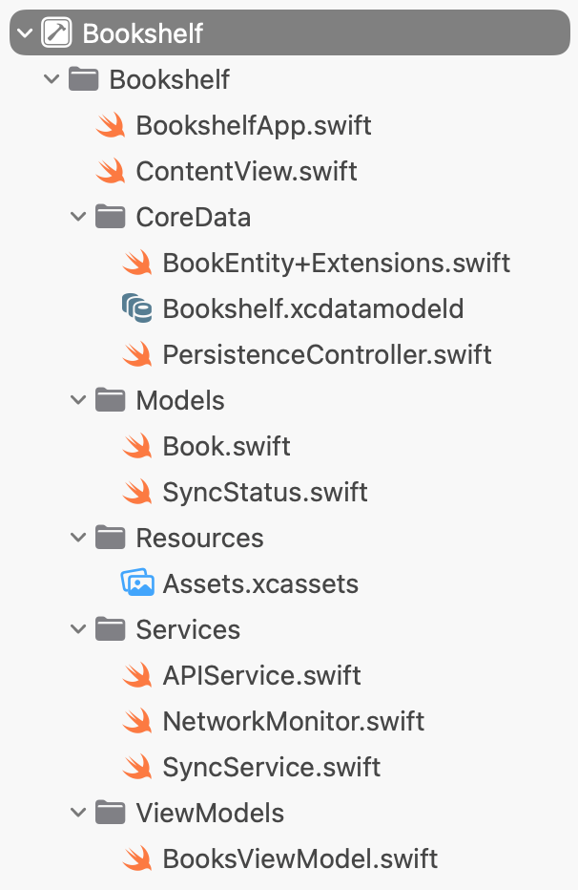
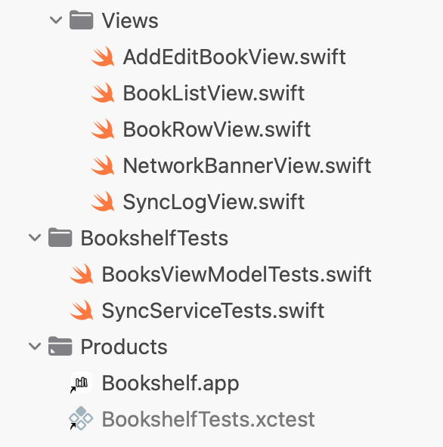
Struktura fajlova

Slide 21
Testiranje
18 unit testova
BooksViewModelTests (9)
• addBook_whileOffline_isPending
• updateBook_marksPending
• deleteBook_onlyRemovesTargetBook
SyncServiceTests (9)
• failedBooks_areRetried
• concurrentSyncCalls_doNotDuplicate
• newBook_usesCreate / existingBook_usesUpdate

Slide 22
Test strategija - SyncServiceTests.swift
final class MockAPIService: APIService {
var shouldFail = false
var createCallCount = 0
var updateCallCount = 0
override func createPost(title: String, body: String,
userId: Int = 1) async throws -> RemotePost {
createCallCount += 1
if shouldFail {
throw APIError.networkError(URLError(.notConnectedToInternet))
}
return RemotePost(id: 101, title: title, body: body, userId: userId)
}
override func updatePost(id: Int, title: String,
body: String) async throws -> RemotePost {
updateCallCount += 1
if shouldFail { throw APIError.networkError(...) }
return RemotePost(id: id, title: title, body: body, userId: 1)
}
}
// setUp
persistence = PersistenceController(inMemory: true)
mockAPI = MockAPIService()
syncService = SyncService(persistence: persistence, api: mockAPI)
Jedan konkretan test:
func test_concurrentSyncCalls_doNotDuplicate() async throws {
let ctx = persistence.viewContext
_ = makeEntity(in: ctx, title: "Once Only")
try ctx.save()
async let first = syncService.syncPendingBooks()
async let second = syncService.syncPendingBooks()
_ = await (first, second)
XCTAssertLessThanOrEqual(mockAPI.createCallCount, 1,
"Concurrent sync calls must not duplicate API requests")
}

Slide 23
Pokretanje testova
U Xcode-u:
Product → Test (⌘U)
Iz terminala:
xcodebuild test \
-project “Trusty Bookshelf.xcodeproj” \
-scheme Bookshelf \
-destination 'platform=iOS Simulator,name=iPhone 15 Pro'

Slide 24
Ograničenja i unapređenja
Ograničenja
Nema autentifikacije
Mock API
Last-Write-Wins merge
Nema background sync između pokretanja
Unapređenja
SwiftData (naslednik CoreData)
Cloudkit (Apple-ov sync)
CRDTs za kolaboraciju
Šifrovanje lokalne baze

Slide 25
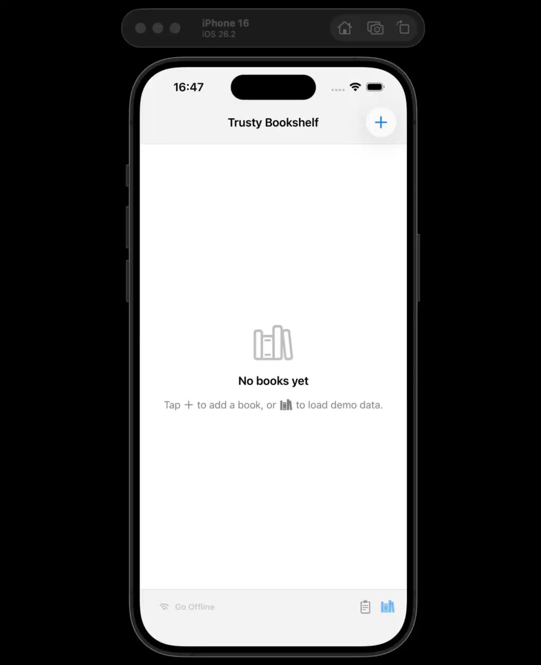
Demonstracija aplikacije

Slide 26
Hvala na pažnji!

